Slide 1
COMPUTER ORGANIZATION AND ARCHITECTURE

Slide 2
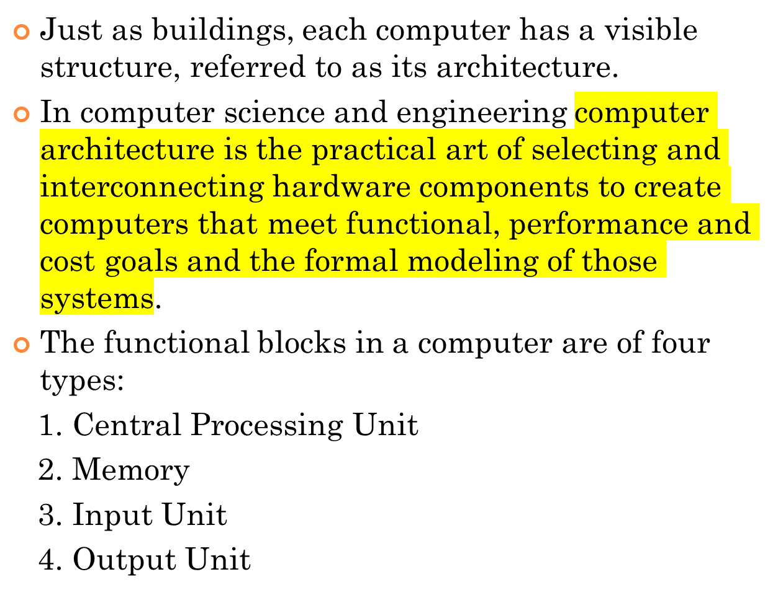
INTRODUCTION

Slide 3
DATA FLOW BETWEEN CPU, MEMORY AND I/O DEVICES
Data Path
Control Signals
Auxilliary Storage
(Backing Storage)
To Supplement main storage
Memory
Input Unit
Output Unit
Control Unit
ALU
Registers
Processor

Slide 4
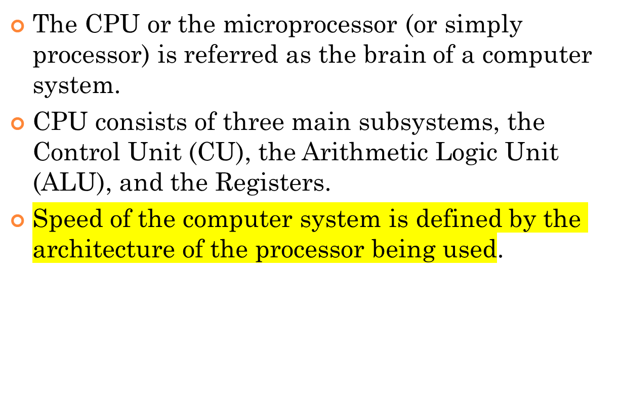
CENTRAL PROCESSING UNIT (CPU)

Slide 5
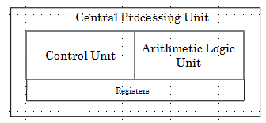
CENTRAL PROCESSING UNIT (CPU) (CONDT…)

Slide 6
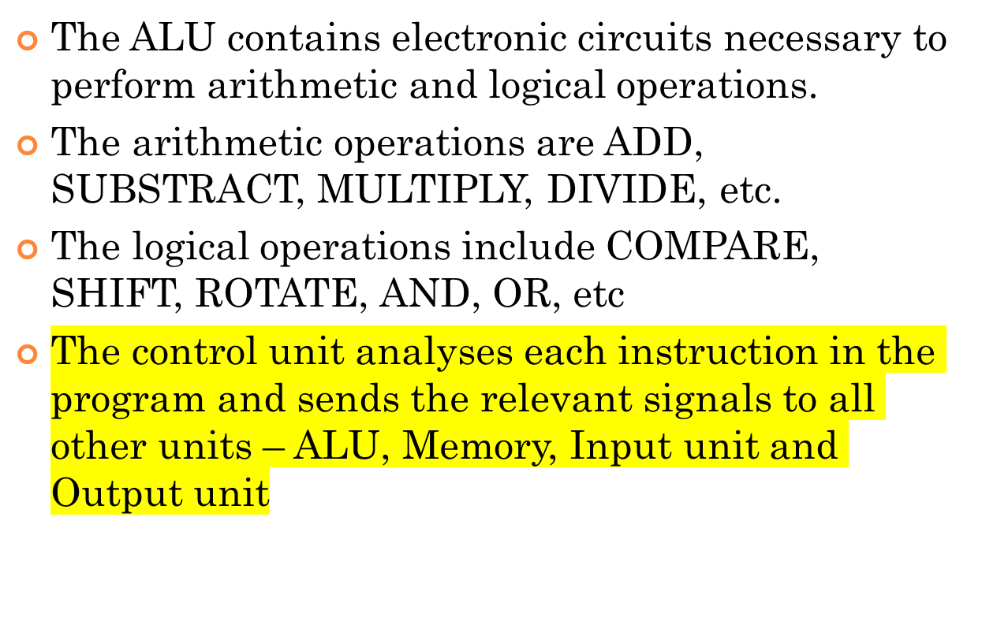
ARITHMETIC LOGIC UNIT

Slide 7
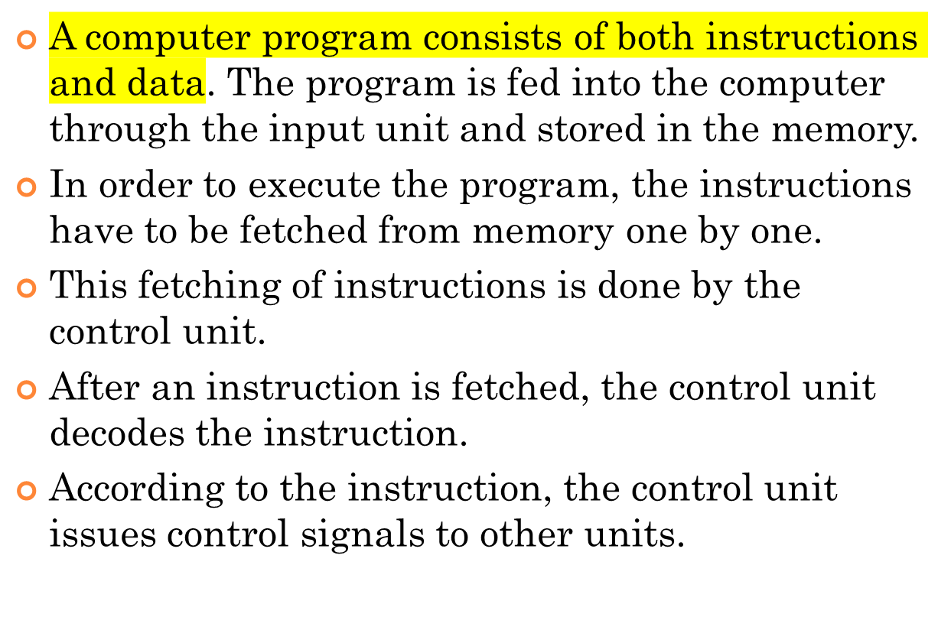
COMMUNICATION INSIDE A COMPUTER..

Slide 8
COMMUNICATION INSIDE A COMPUTER..
After an instruction is executed, the result of the instruction is stored in memory or stored temporarily in the control unit or ALU, so that this can be used by the next instruction.
The results of a program are taken out of the computer through the output unit.
The control unit, ALU and registers are collectively known as Central Processing Unit (CPU)

Slide 9
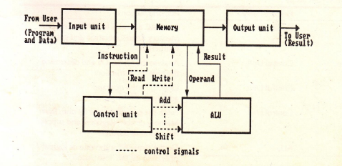
COMMUNICATION INSIDE A COMPUTER

Slide 10
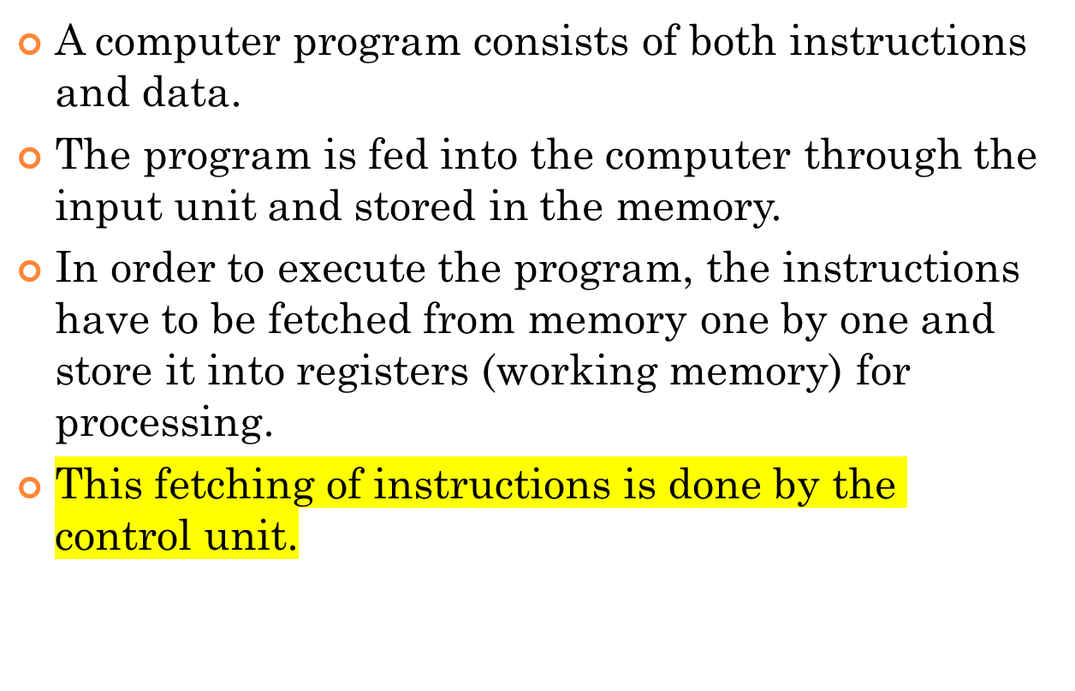
INTERCONNECTION OF UNITS

Slide 11
INSTRUCTION CYCLE
Instruction are fetched and executed by the control unit one by one. The sequences involved for the fetch of one instruction and its execution are known as instruction cycle.
Notes:
In all computer languages, expressions consist of two types of components: operands and operators. Operands are the objects that are manipulated and operators are the symbols that represent specific actions. For example, in the expression
5 + x
X and 5 are operands and + is an operator. All expressions have at least one operand.

Slide 12
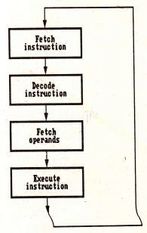
INSTRUCTION CYCLE
Notes:
In all computer languages, expressions consist of two types of components: operands and operators. Operands are the objects that are manipulated and operators are the symbols that represent specific actions. For example, in the expression
5 + x
X and 5 are operands and + is an operator. All expressions have at least one operand.

Slide 13
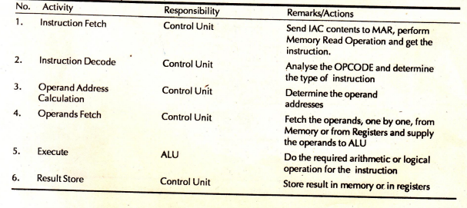
INSTRUCTION CYCLE STEPS
Notes:
IAC= INSTRUCTION Address Counter, MAR= Memory Address Register, OPCODE= Operation Code

Slide 14
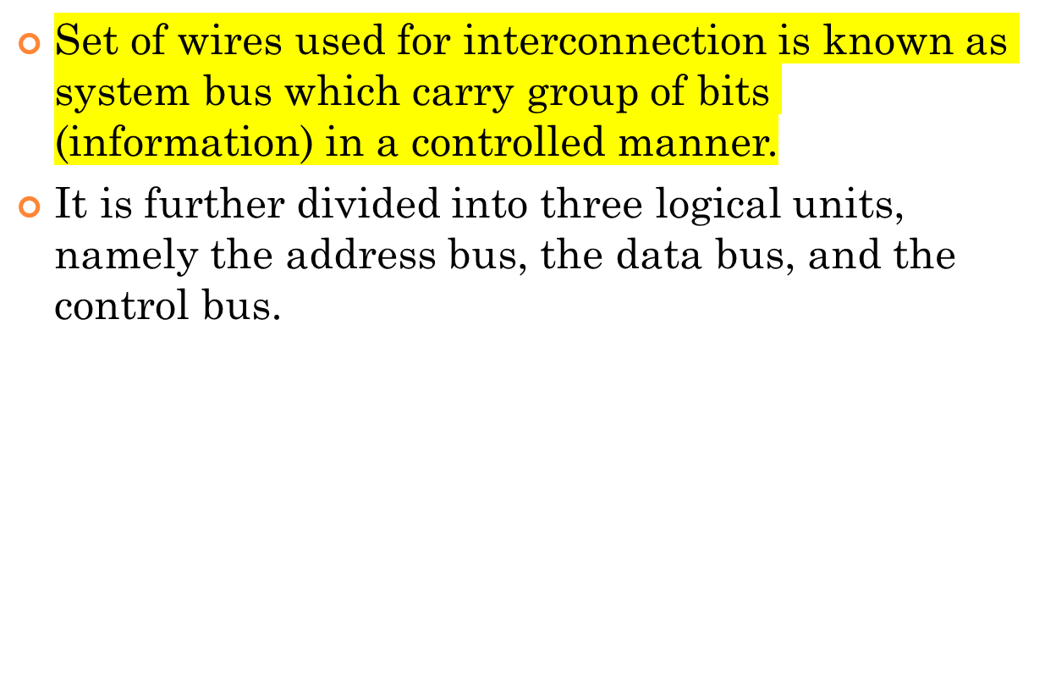
INTERCONNECTIONS OF UNITS..

Slide 15
SYSTEM BUSES TYPES
Data Bus: The data bus is used when any unit is sending data, instruction or command code to some other units.
Address Bus: The address bus is used when one unit is sending an address information i.e. location of the data residing in the memory to another unit.

Slide 16
CONTROL BUS
Control Bus: The control bus is responsible for making CPU, memory and I/O devices work together as a functional system, carrying signals that report the status (ready, not ready) of various units.
The function of a control bus is to determine and instruct according to the operation type (Read or Write). For example, if the processor or an I/O device wants to read or write a value from memory, the control bus will specify it.

Slide 17
PROCESSING OF INFORMATION
The bus is common to all the units in the computer. Before sending some information on the bus, an unit should verify whether the bus is free or occupied with some communication started by some other unit.
CPU is the bus master in a computer which decides who should control the bus when more than one unit wants the bus at the same time.
An unit who needs the bus makes a request to the CPU and waits sanction. Till the CPU issues sanction, the requesting unit does not attempt to use the bus.

Slide 18
INTERCONNECTION OF COMPUTERS UNITS VIA SYSTEM BUS
CPU
Memory Unit
Input and Output(I/O) Units
Data Bus
Address Bus
Control Bus
System Bus

Slide 19
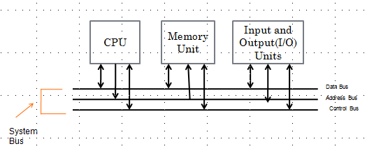
INTERCONNECTION OF COMPUTERS UNITS VIA BUS
Shows how the system bus interconnects the processor, memory and I/O devices.
Both processor and memory units hold a bi-directional relationship with the control and data bus.

Slide 20
INTERCONNECTION OF COMPUTERS UNITS VIA BUS
In case of an address bus, the communication with processor and memory is unidirectional.
Processor provides location of data (stored in the register) to be fetched from the memory to the address bus and the data carries the required data to the processor.

Slide 21
INTERCONNECTION OF COMPUTER UNITS VIA BUS
I/O devices have a bi-directional relationship with the system bus.

Slide 22
REGISTERS
It is a special temporary storage location within the CPU.
Registers quickly accept, store and transfer data and instructions that are being used immediately.
To execute an instruction, the control unit of the CPU retrieves it from main memory and places it onto a register.
The typical operations that take place in the processing of instruction are part of the instruction cycle or execution cycle.
The instruction cycle refers to the retrieval of the instruction from main memory and its sub sequence at decoding.
The time it takes to go through the instruction cycle is referred to as I-time.

Slide 23
ARITHMETIC LOGIC UNIT (ALU)
ALU performs all the arithmetic and logical functions.
It performs arithmetic as well as logical functions.
The speed of the computer system is defined by the architecture of the processor being used.

Slide 24
CONTROL UNIT
It is responsible for directing and coordinating most of the computer system activities.
It does not execute instructions by itself. It tells other parts of the computer system what to do.
It determines the movement of electronic signals between the main memory and arithmetic logic unit as well as the control signals between the CPU and input/output devices.

Slide 25
CONTROL UNIT(CONDT…)
To complete an event i.e. processing, control unit repeats a set of four basic operations:
Fetching is the process of obtaining a program instruction or data item from the memory
Decoding is the process of translating the instruction into commands the computer can execute.
Executing is the process of carrying out the commands.
Storing is the process of writing the result to memory.

Slide 26
CONTROL UNIT(CONDT…)
The internal communication inside a computer that transforms raw data into useful information is called processing.
To perform this transformation, the computer uses two components- processor and memory
The program is fed into the computer through the input unit and stored in the memory
To execute the program, the instructions have to be fetched from memory one by one which is done by control unit
Then the control unit decodes the instruction.

Slide 27
CONTROL UNIT(CONDT…)
According to instruction, control unit issues signals to other units.
After instruction is executed, the result of the instruction is stored in memory or stored temporarily in the registry, so that this can be used by the next instruction.
The results of a program are taken out of the computer through the output unit.

Slide 28
MEMORY
Memory is the computer's electronic scratchpad or local store in computer terminology.
Used for temporary storage of calculations, data, and other work in progress.
Two types: Primary and Secondary
Primary memory or the main memory is part of the main computer system. The primary memory itself is of two types.
The first is called random access memory (RAM) and the other is read only memory (ROM).

Slide 29
RANDOM ACCESS MEMORY (RAM)
The processor directly stores and retrieves information from it.
Memory is organized into locations. Each memory location is identified by a unique address. The access time is same for all location.
It is volatile: when turned off, everything in RAM disappears.
Two types:

Slide 30
TYPES OF RAM
Dynamic Random Access Memory (DRAM):
This type RAM retain the content of any location only for a few milliseconds. Within that period, each location must be written again with the same contents. This is known as refreshing.
Static Random Access Memory (SRAM):
This type of RAM preserves the contents of all the locations as long as the power supply is present. SRAM is generally included in a computer system by the name of cache.

Slide 31
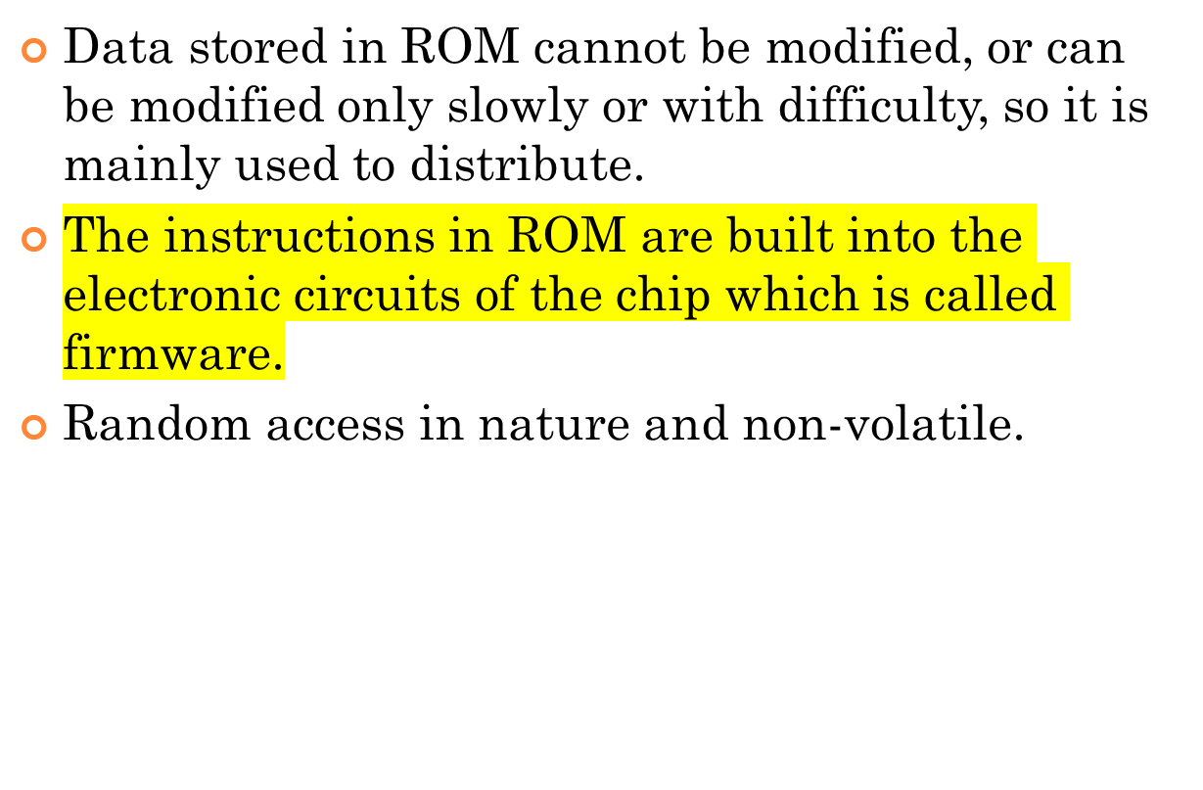
READ ONLY MEMORY (ROM)

Slide 32
TYPES OF ROM
Programmable read-only memory (PROM), or one-time programmable ROM can be written to or programmed via a special device called a PROM programmer.
Erasable programmable read-only memory (EPROM) can be erased by exposure to strong ultraviolet light then rewritten with a process that again needs higher than usual voltage applied.
Electrically erasable programmable read-only memory (EEPROM) is based on a similar semiconductor structure to EPROM, but allows its entire contents (or selected banks) to be electrically erased, then rewritten electrically, so that they need not be removed from the computer

Slide 33
FLASH MEMORY
Modern type of EEPROM invented in 1984.
Random access memories and are non-volatile.
Use one transistor per memory cell and come in capacities ranging from 1 MB to 32 GB by the year 2007.
The read time is much smaller (tens of nanoseconds) compared write time (tens of microseconds).

Slide 34
VARIETIES OF SEMICONDUCTOR RANDOM ACCESS MEMORIES
Main memory of computers
Read Only Memory (ROM)
Read/Write memory
Factory Programmed
User Programmable PROM
Erasable PROM
SRAM
DRAM
Permanent non-erasable
(Non-erasable)
UVEPROM
EEPROM

Slide 35
CACHE MEMORY
High speed memory kept in between processor and RAM to increase the data execution speed.
Kept near to the processor.
Major reason for incorporating cache in the system is that the CPU is much faster than the DRAM and needs a place to store information that can be accessed quickly.
Cache fetches the frequently used data from the DRAM and buffers (stores) it for further processor usage.

Slide 36
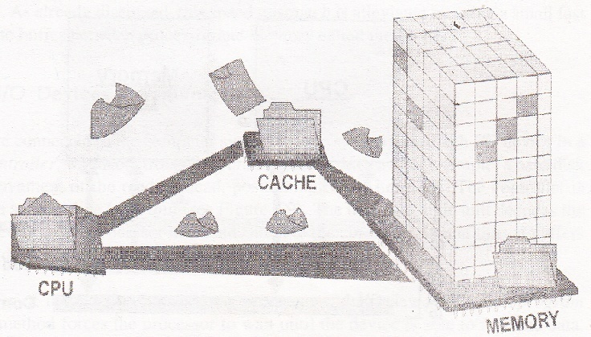
CACHE MEMORY

Slide 37
DIFFERENT LEVELS OF CACHE
L1-cache is the fastest cache and it usually comes within the processor chip itself. L1 cache typically ranges in size from 8KB to 64KB and uses the high-speed SRAM instead of the slower and cheaper DRAM used for main memory.
L2 cache comes between L1 and RAM and is bigger than the primary cache.
L3 cache is not found nowadays as its function is replaced by L2 cache. L3 caches are found on the motherboard rather than the processor. It is kept between RAM and L2 cache.

Slide 38
PROCESSOR SPEED
Speed of a computer system is determined by several factors, clock speed of the processor and the speed and size of the data bus.
Clock speed is the rate at which the processor processes information and this is measured in millions of cycles per second(Megahertz)
The more the number of hertz, the faster is the processing speed
The larger the bus width and the faster the bus speed, the greater the amount of data can travel on it in a given amount of time.

Slide 39
INPUT DEVICES
Any peripheral used to provide data and control signals to an information processing system such as a computer or other information appliance.
Common input devices: Keyboard, Mouse
Other devices: microphone, digital camera, scanner.

Slide 40
OUTPUT DEVICES
Any piece of computer hardware equipment used to communicate the results of processed data to the user.
Examples: Monitors, Printers, Speakers, etc.

Slide 41
LET US SUMMARISE..
Computer organization and architecture is defined as the science of selecting and interconnecting hardware components to create computers that meet functional, performance and cost goals.
The central processing unit is the brain of the computer system where all the computing is done. It consists of three main components, the control unit (CU), the arithmetic logic unit (ALU) and the registers.
The control unit controls the Input/Output devices and transfer of data to and from the primary storage.

Slide 42
ANSWER IN BRIEF
Write a note on computer architecture
What is a system bus? Name the various units of the system bus.
What is the significance of main memory in proper functioning of a processor.
What is an Instruction cycle?

Slide 43
ANSWER IN DETAIL
What do you understand by Central Processing Unit? Describe in details various units of the CPU.
Write a detailed note on Instruction Cycle describing the various steps involved.
Describe in details:
a. Processor to Memory Communication
b. Processor to I/O Devices Communication

Slide 44
LET US SUMMARISE..
The Arithmetic Unit is responsible for carrying out the arithmetic calculations such as addition, subtraction, multiplication, and division.
The Logic Unit provides CPU the ability to make logical operations like comparing two data items and taking different actions based on the results of the comparison.
Registers are special purpose, high-speed temporary memory units used by the processor for holding data.

Slide 45
LET US SUMMARISE..
The System bus is a set of wires used for interconnection of different units of a computer system. The three logical units of a system bus are the address bus, the data bus, and the control bus.
A cache is a piece of very fast memory, made from high-speed static RAM that reduces the access time of the data. It is very expensive and generally incorporated in the processor, where valuable data and program segments are kept.

Slide 46
LET US SUMMARISE..
Instructions comprise two parts, namely, the op-code and the operand. They are transferred one at a time into the processor, where they are decoded and the executed.
The Instruction Cycle details the sequence of events that takes place as an instruction is read from memory and executed.
In a Fetch Cycle, instruction to be executed is fetched from the memory to the processor.
The Decode Cycle is responsible for recognizing which operation the instruction represents activating the correct circuitry to perform that operation.

Slide 47
LET US SUMMARISE..
During the Execute Cycle, the operation specified by the op-code is performed on user provided data in the ALU.
In the Store Cycle, the results from the execution cycle are stored back to the memory.
Processors are built with the ability to execute a limited set of basic operations called the Instruction Set.
The speed of the processor is measured in millions of cycles per second or Megahertz (MHz).

Slide 48
LET US SUMMARISE..
Two notables factors on which the speed of a processor depends are the clock speed of the processor and the speed and the size of the data bus

